Slide 1




From the white ears of Ofsted to the word gap:
language policing as a design feature of English education
The 22nd Harold Rosen Lecture, March 2023
Dr Ian Cushing
Edge Hill University
(Manchester Metropolitan University as of June 2023)

Slide 2
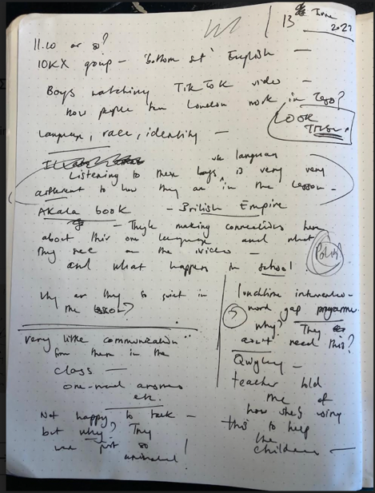
Fieldwork notes (June 2022)
Secondary school in an economically-deprived area of south-east London with a large proportion of Black Caribbean children and an over-representation of white staff.
I am waiting in the classroom and chatting to a group of young Black boys, who talk about race, power and identity and how in school, they are perceived to use language in ways which are deficient.
They display linguistic dexterity and knowledge about language, using content-specific vocabulary, rhetorical flair, and complex syntax to do so.
The school perceives their skills differently – their language is described as ‘limited’, ‘lazy’ and ‘inappropriate’; they are told to speak ‘properly’ in standard English; the school subscribes to ideologies of the ‘word gap’ in their policies, and they are subjected to scripted lessons in order to try and ‘fix’ their supposed defects.
In lessons I observe, the boys keep quiet, produce one-word answers and are told by their teacher to use ‘more academic’ vocabulary.
Not a critique of an individual teacher, but of a policy architecture underpinned by anti-Black and white supremacist language ideologies.

Slide 3
Durable narratives about language and schools
Social and urban decay blamed on marginalised communities
Degenerate communities which require remediation
Chaotic classrooms and homes
Declining standards and poor vocabulary
Racial justice achieved by modifying individual behaviours

Slide 4
Durable narratives about language and schools
Social and urban decay blamed on marginalised communities
Degenerate communities which require remediation
Chaotic classrooms and homes
Declining standards and poor vocabulary
Racial justice achieved by modifying individual behaviours
… the view that if particular groups would just embrace [standard English; academic language] they would be provided readymade access to mainstream societal inclusion and upward socioeconomic mobility. This perspective interprets structural inequality as a linguistic problem requiring linguistic solutions, rather than as a politico-economic problem requiring politico-economic solutions.
(Rosa 2016: 165)

Slide 5
A raciolinguistic perspective
Exposes the long, colonial histories of how racialised communities get categorised as linguistically deficient, even when they produce language which is deemed skilful, legitimate and praiseworthy when produced by privileged white speakers (Rosa & Flores 2017; Snell 2018; Cushing & Snell 2022).
Rejects the assumption that if racialised populations learn to engage in normative language practices they will be recognised as legitimate language users
Rejects the idea that language-based interventions are the solution to structural inequalities.
Shifts the attention away from stigmatised speakers and towards the white listening subject: an institutional mode of perception which refers not to malicious individuals, but to policies, curricula, assessments, interventions and other forms of linguistic surveillance which categorise marginalised speakers in need of perpetual remediation.

Slide 6
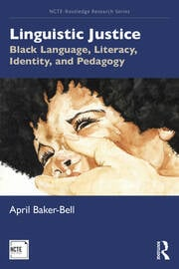
Raciolinguistic ideologies and anti-Black linguistic racism
Anti-Black linguistic racism captures the dehumanisation that Black speakers endure when using their language across multiple contexts, including classrooms, and it details the ways that anti-Blackness in language education positions Black students as linguistically, intellectually, and morally inferior.
Through mainstream narratives about language, these children are instructed to modify their own natural language so that it becomes closer to that of the white, middle-classes.
Baker-Bell (2020: 13)

Slide 7
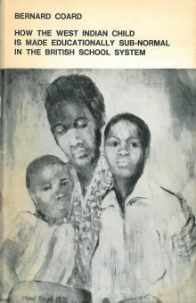
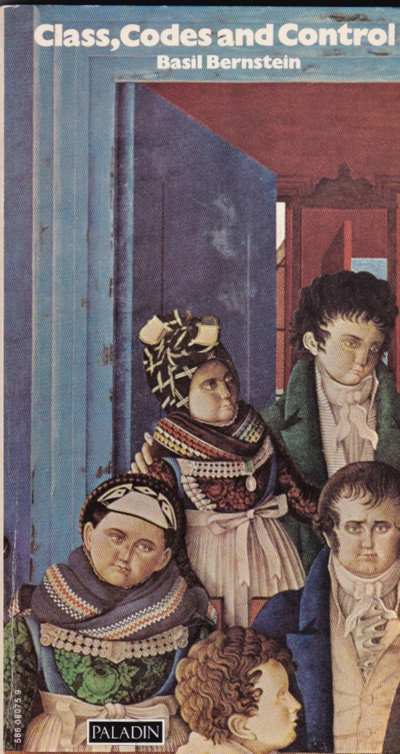
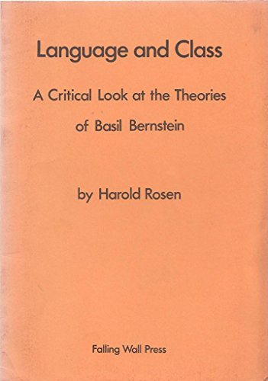
Anti-Black linguistic racism, ‘restricted codes’ and 1971
Coard 1971
Bernstein 1971
Rosen 1974

Slide 8
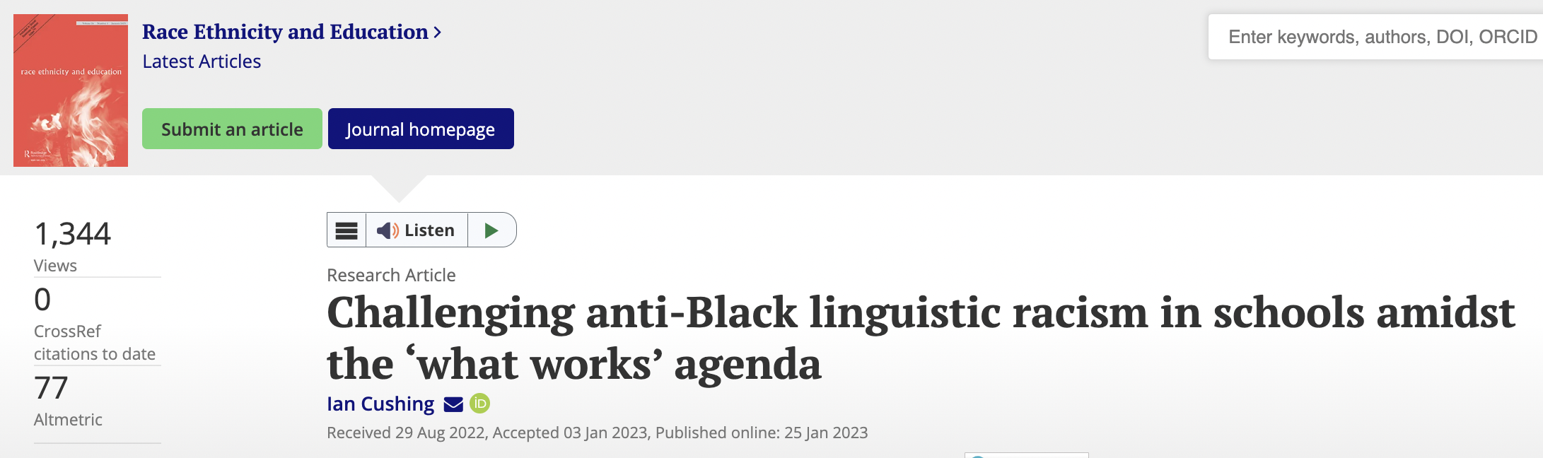
‘Appropriateness’
Rosen (1974) was an early critic of appropriateness-based language education as espoused by Basil Bernstein and Dell Hymes, showing how ‘appropriate’ simply worked as a proxy for ‘correct’ or ‘standard’.
My own work (Cushing 2023) has shown that racialised children’s and teacher’s language continues to be stigmatised even when it resembles language deemed appropriate when produced by white, privileged children and teachers.
Rosen’s ideas continue to be central to a raciolinguistic perspective, where we continue to push back against policies and pedagogies which require racialised children to modify their language so that it resembles idealised linguistic whiteness (Cushing & Snell 2022; Flores & Rosa 2015).
This perspective refuses to place responsibility on the speaker to change their practice, but on the listener.

Slide 9
“They were always like questioning whether my accent was something I wanted to think about addressing … at one point they even said that going to elocution lessons might be worth thinking about…
…but they never told the white teachers who also spoke with East London accents to do that…yeah it was pretty horrible, like I was being singled out and like I didn’t belong”
Rebecca, pre-service teacher
Cushing, I. (f.c.) "Miss, can you speak English?” Raciolinguistic ideologies and language oppression in initial teacher education. British Journal of Sociology of Education.

Slide 10
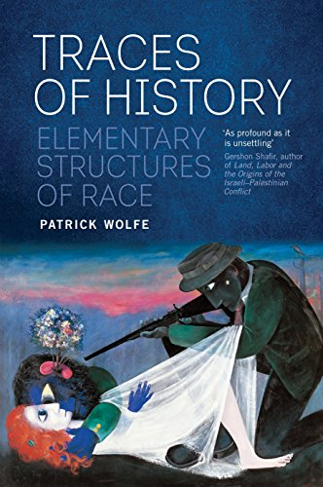
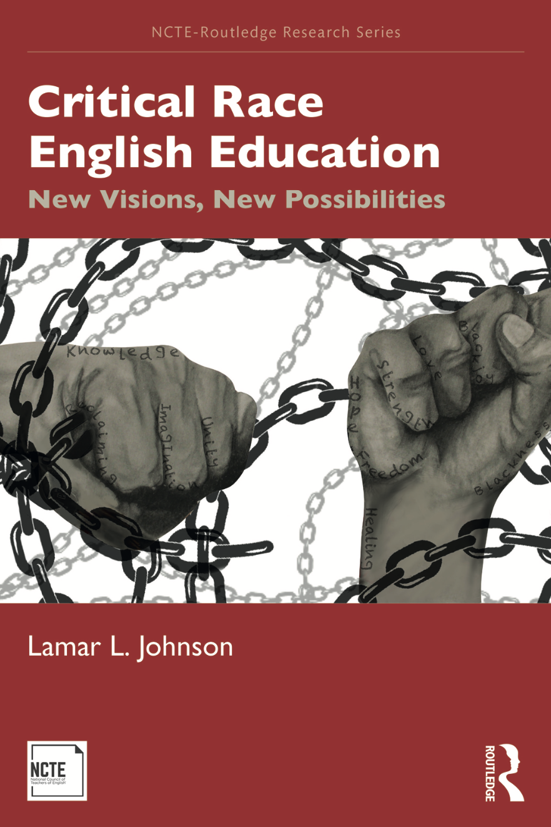
Language policing is a structure, not an event

Slide 11
Anti-Blackness is a design feature of English education
Type | Example as applied to England
Physical violence | The presence of police offers in school which further criminalises Black children (e.g. Joseph-Salisbury 2021); anti-Black hair policies (Banks 2000).
Linguistic violence | Ofsted’s hostile policing of language (Cushing & Snell 2022); so-called word gap interventions which miscategorise Black, working-class children’s language (Allen & Spencer 2022; Cushing 2023).
Curricular and pedagogical violence | National curricula rooted in white supremacist and colonial logics which deny Black voices a space in the classroom (e.g. Iffath 2020).
Systemic school violence | Punitive behaviour policies (e.g. Bei et al 2021) and teacher education policies built on whiteness (e.g. Lander 2014).

Slide 12
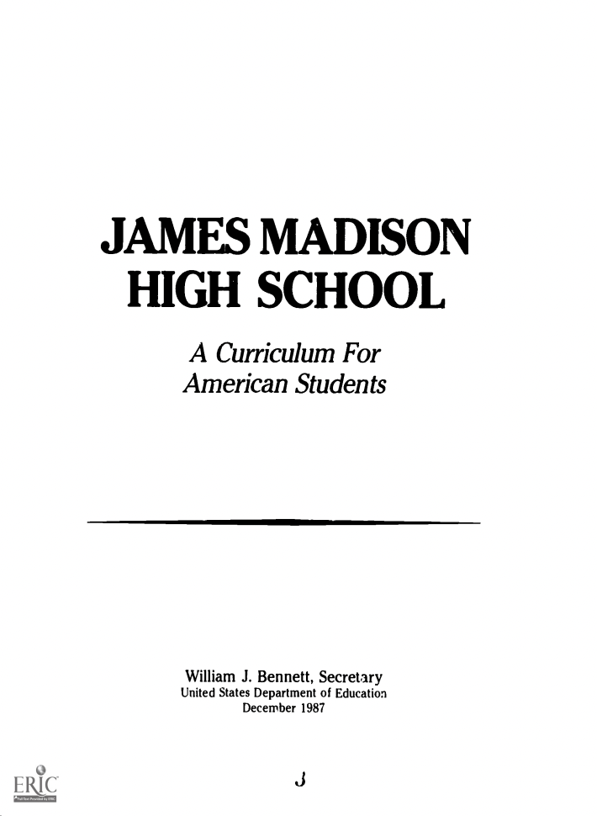
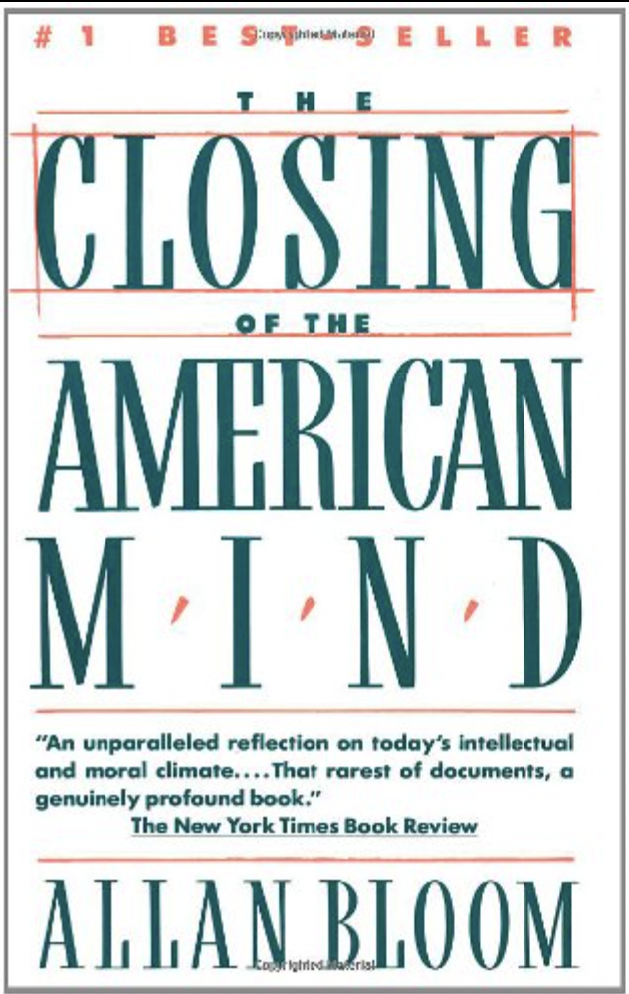
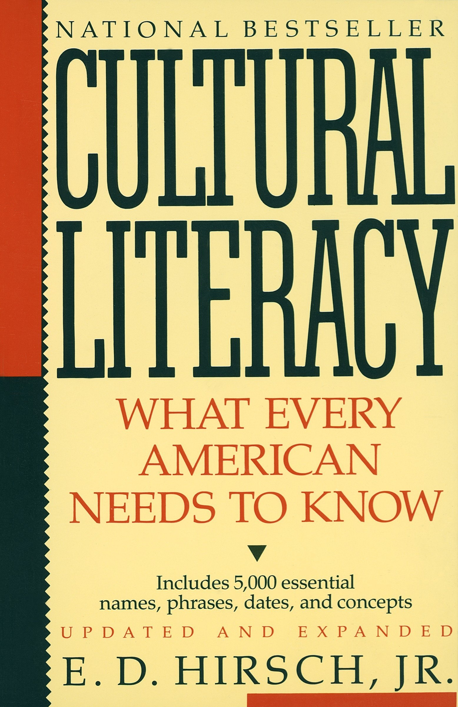
Curriculum as colonial: the knowledge-rich project
If a young child’s speaking and listening skills have been so impoverished by growing up in a limited linguistic environment, no effort should be spared to enhance those foundational oral-aural skills as a prerequisite for further literacy skills.
Hirsch (1996: 147)
Bennett 1987
Bloom 1987
Hirsch 1987
See Cushing 2023; Hodgson & Harris 2022; Yandell 2017

Slide 13
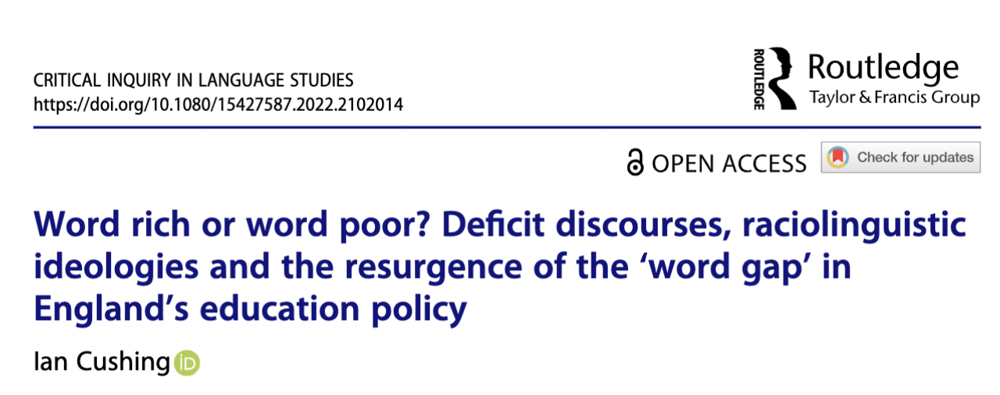
Punishing words: deficit discourses and the word gap

Slide 14
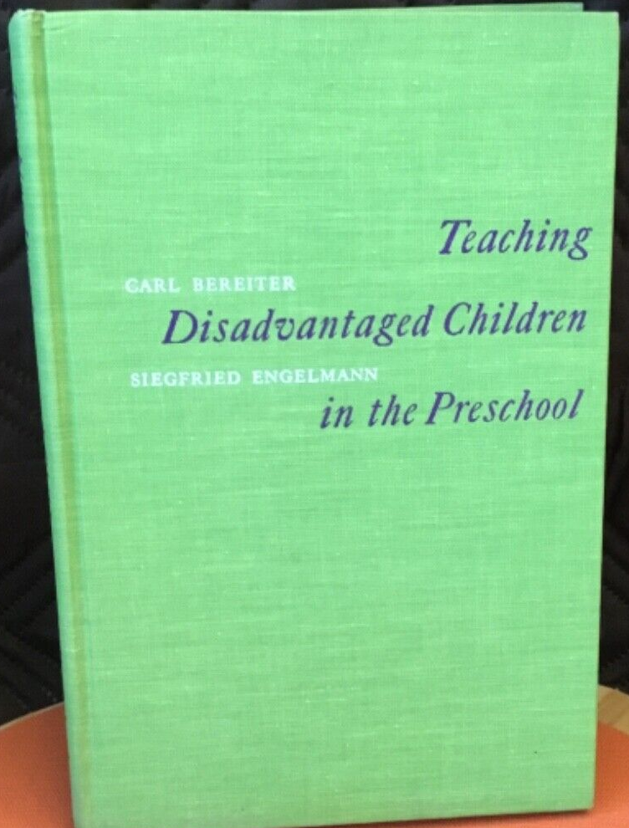

Punishing words: deficit discourses and the word gap
British colonisers would regularly describe the vocabulary size of Indigenous and Black enslaved Africans as limited, small and lacking
Reproduced in mid-20th Century UK sociology (e.g. Bernstein 1958) with some psychologists (e.g. Deutsch 1967; Jensen 1969; Riessman 1962) arguing that linguistic deficits are genetic, perpetuating connections between language, racial hierarchies and biological racism.
Bereiter and Engelmann (1966) claimed that low-income, racialised children suffer from ‘verbal deprivation’, with Direct Instruction offered as a solution – a programme which has seen a resurgence in contemporary policy under a guise of ‘evidence-informed’ practice
Rosen (1974) exposed the racism within deficit perspectives but they continue to be durable because they shift attention away from state-crafted structures of inequality.
Deficit perspectives revived in 1995 with the publication of Betty Hart and Todd Risley’s book Meaningful Differences in the Everyday Experience of Young American Children…

Slide 15
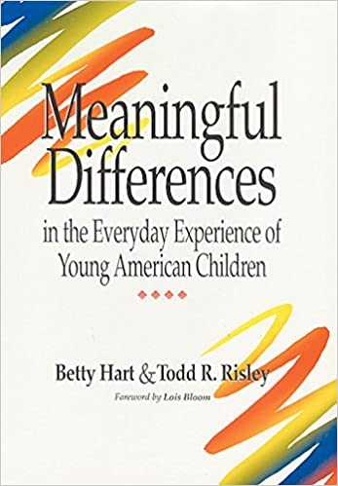
Claimed that high-income white families talk more frequently and with a wider variety of vocabulary than low-income Black families.
Monthly, 1-hour observations of 42 families in Kansas City from three different socio-economic categories (‘professional’; ‘working class’ and ‘welfare’).
Calculated the average hourly rate of words spoken to children and then extrapolated these numbers to suggest that by the age of four, children from low-income families have heard 30-million fewer words than their high-income counterparts: the ‘word gap’.
From the 13 families in the ‘professional’ category, 1 of these were African American; from the 6 families in the ‘welfare’ category, all 6 were African American.
Hart & Risley (1995)

Slide 16
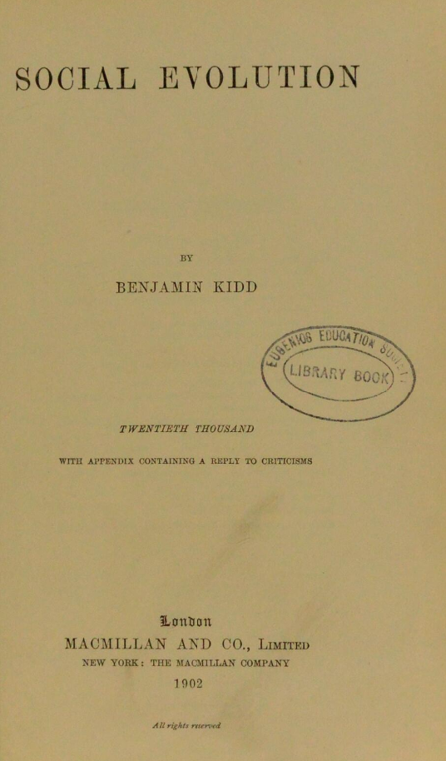
…but these ideologies have a long history
The lower races have, as a rules, no words in their languages to express many of the more complex ideas and relationships that have been familiar to members of the higher races from childhood […]. These savages are incapable of abstract thought.
(Kidd 1894: 273).

Slide 17
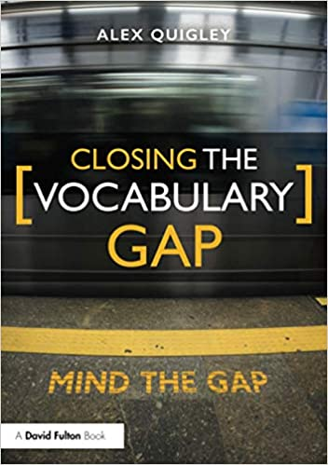
Ideologies of linguistic deficit turned into economic profit
An industry built on the word gap, with a failure to engage with existing criticisms whilst recycling long-established deficit discourses.
Racialised children living in poverty as literally ‘unable to describe their world’:
  Consider that fact for a moment: these ‘word poor’ children are left unable to describe their world. For our children then, the limits of their vocabulary really do prove the limits of their world. (2018: 6)
…subscribes to the reductive logic that structural inequalities can be addressed through linguistic interventions:
  There are then thousands of small solutions to the damaging inequalities that we observe in our society and in our classrooms, and they can be found in the English dictionary. (2018: 2)

Slide 18
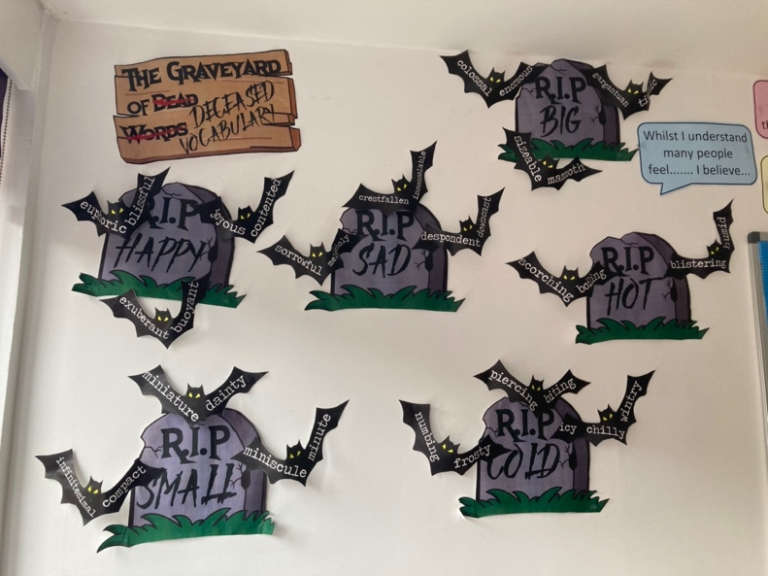
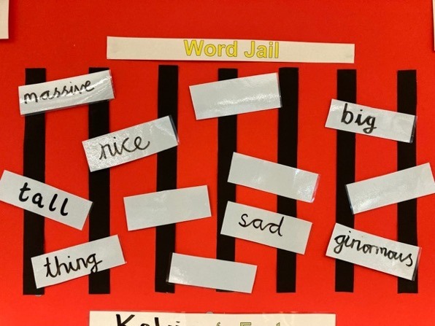
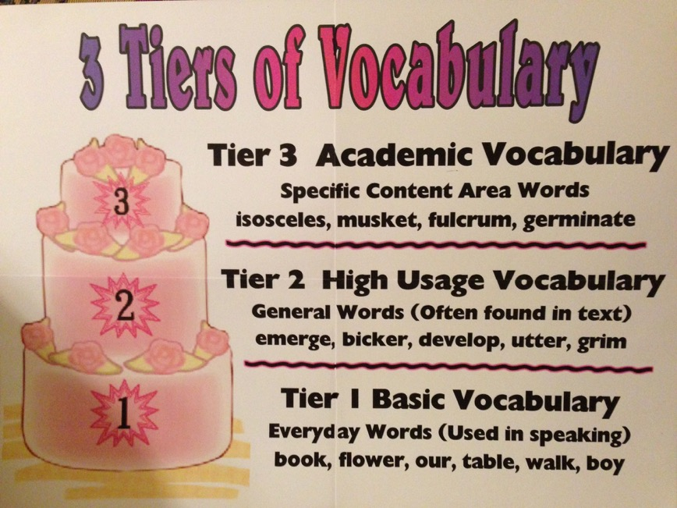
From word gaps to… word graveyards, jails, and tiers
Whilst teachers justified these practices in the language of ‘evidence-based’ pedagogy, the consequences were that children had their natural language practices policed because they were deemed to violate hierarchically organised taxonomies of what constituted ‘academic’ vocabulary’. Teachers came to see ‘home’ and ‘academic’ language as discrete and dichotomous categories, with only the ‘academic’ category granted legitimacy.
And these ideologies granted further legitimacy by the white ears of Ofsted…

Slide 19
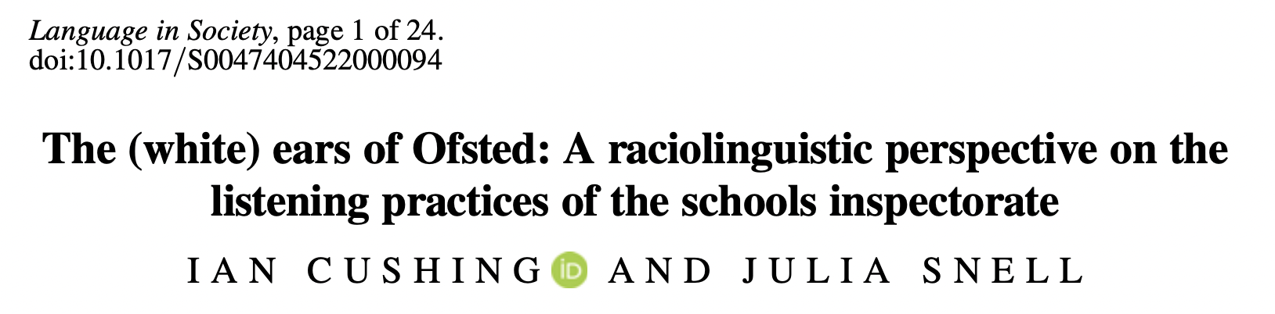
England has had a schools inspectorate since 1839, inspecting schools in Britain and former British colonies in which it regularly called for the eradication of nonstandard language varieties in schools.
Latest statistics show that 92% of Ofsted inspectors are white.
Ofsted act as agents of sonic surveillance, with institutional judgements about language enacted from positions of extreme power.

Slide 20
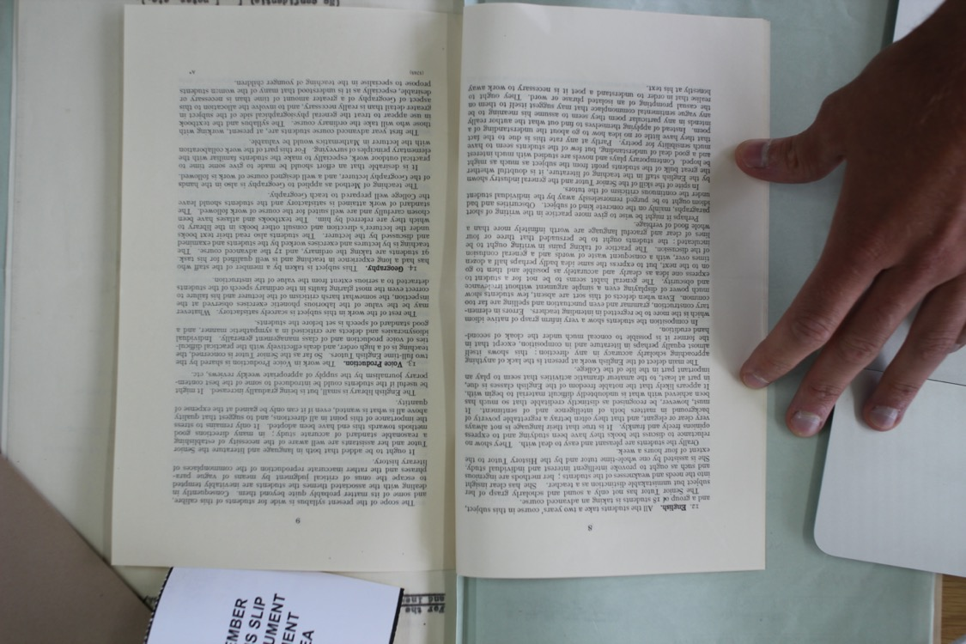
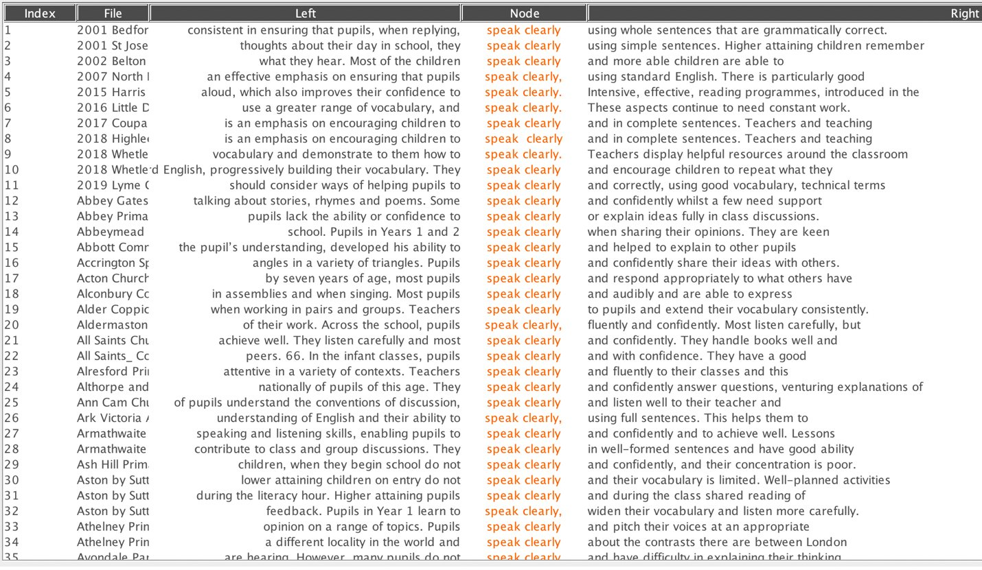
Inspecting the white ears of Ofsted
Inspection reports held at the National Archives (1839 – 2000)
Corpus of 100,000 contemporary reports (2000 – 2020)
Searched for textual traces of language ideologies: ‘speak clearly’, ‘correct grammar’, ‘standard English’, ‘articulate speech’, etc
Examined relations between school demographics in terms of race/class and language ideology

Slide 21
Sonic surveillance of teachers
Approval given to schools who engage in hostile language policing
Teachers insist that students answer questions using correct grammar and in complete sentences (2012)
Students are challenged to write and speak accurately, without slang or colloquial language. The academy's progress in almost eradicating the use of ‘like’ by students is one example of this hugely successful focus (2014)
Quality of speech equated with quality of teaching
Teachers model standard English continuously and help pupils to enunciate correctly (2019)
Teachers have brought about considerable improvements … although the local dialect is still a powerful influence on the spoken word (2002)
Non-standard English perceived as a barrier to learning
Some adults have weak spoken standard English and grammar. Too many staff make errors in their standard spoken English when they teach. In some cases, this means that they model bad habits or teach incorrect grammar. Staff need to do more to correct pupils’ poor language or vocabulary. (2019)

Slide 22
Language ideologies are never just about language
The more able pupils are mainly speaking standard English in school, with sound pronunciation and good sense. A few pupils lack clarity in their speech which results in some confusion in the way they say “t” and “th”, as “d” or “f”.
Moss Side, Manchester
Racialised students living in poverty are particularly likely to be targets of hostile language policing […]. Despite Ofsted's recent claims that ‘equality, diversity and inclusion are at the heart of our work’ (Ofsted 2021: 57), we firmly reject this and argue that our research has exposed how deficit-orientated listening practices are in fact institutionally embedded into the very heart of the inspectorate's ideologies and policies.
(Cushing & Snell 2022)

Slide 23
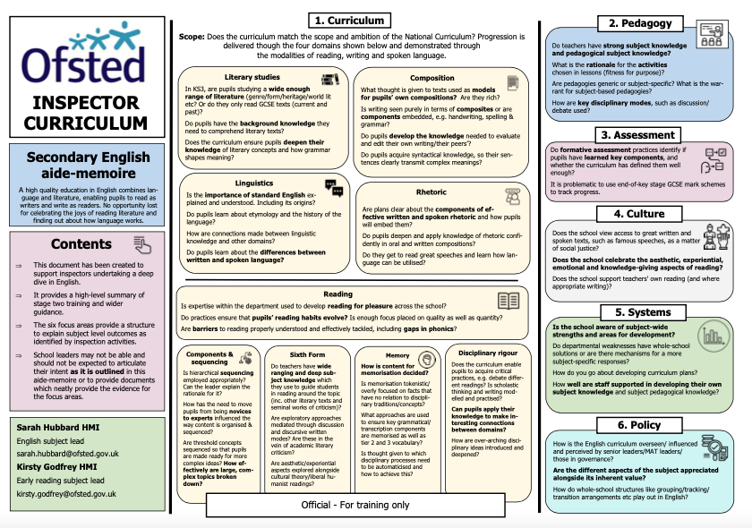
Social (in)justice: language policing is done by design
Recently leaked confidential training materials for inspectors proves how they are being actively trained to listen out for linguistic deficiencies – for example:
  ‘Teachers should also appropriately correct pupils’ grammar when they are speaking formally’
  ‘There are high expectations … teachers have wide-ranging vocabularies. They speak standard English with pupils … Teaching standard English is a matter of social justice.’
Reproduces the ideology that marginalised speakers’ language practices carry little value (Snell 2013).
A view of social justice which places the burden on marginalised speakers to modify the way they talk and maintains the racial/class status quo.

Slide 24
Undoing language policing
Language policing is not simply acts of overt corrections carried out by malicious individuals, but a dense structure which is actively woven into the fabric of education policy and operates under seemingly benevolent guises of social and racial justice.
Language education policy is built on the interests of whiteness, and whiteness is learned (Sriprakash et al 2022). Linguistic whiteness and anti-Black linguistic racism are part of this structure.
Efforts must go beyond simply educating teachers in critical language awareness, but position teachers as anti-racist language activists whose work is concerned with the abolishing of oppressive structures and the complete rejection of reductive language-based solutions to social inequalities.
A raciolinguistic perspective pushes us to connect issues of language struggle with broader structures of inequality and urges us to relocate our attention away from the purportedly deficient language of the stigmatised speaker and towards the oppressive listener.
Through this, we can seek to transform schools as spaces free from social injustice, rather than expecting marginalised children and teachers to transform themselves.

Slide 25
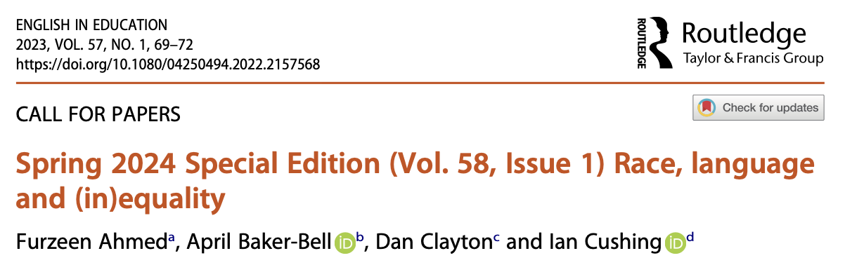
Thank you for listening
Avineri, N & Johnson. E. (2015). Invited forum: bridging the “language gap”. Journal of Linguistic Anthropology 25(1): 66-86.
Baker-Bell, A. (2020). Linguistic Justice: Black Language, Literacy, Identity, and Pedagogy. Routledge.
Bennett, W. (1987). James Madison High School: A Curriculum for American Students. U.S. Department of Education.
Bereiter, C., & Engelmann, S. (1966). Teaching Disadvantaged Children in the Pre-School. Prentice Hall.
Bloom, A. (1987). The Closing of the American Mind. Simon & Schuster.
Coard, B. (1971). How the West Indian Child is Made Educationally Sub-normal in the British School System. New Beacon Books.
Cushing, I. (2023). Challenging anti-Black linguistic racism amidst the ‘what works’ agenda in schools. Race Ethnicity & Education.
Cushing, I. (2023). The knowledge-rich project and the preservation of whiteness in schools: a raciolinguistic perspective. Educational Linguistics.
Cushing, I. (2022). Word rich or word poor? Deficit discourses, raciolinguistic ideologies and the resurgence of the ‘word gap’ in England’s education policy. Critical Inquiry in Language Studies.
Cushing, I. (2021). Language, discipline and ‘teaching like a champion’. British Educational Research Journal 47(1): 23-41.
Cushing, I & Snell, J. (2022). The (white) ears of Ofsted: a raciolinguistic perspective on the listening practices of the schools inspectorate. Language in Society.
Flores, N & Rosa, J. (2015). Undoing appropriateness: Raciolinguistic ideologies and language diversity in education. Harvard Educational Review 85: 149-171.
Hart, B & Risley, T. (1995). Meaningful Differences in the Everyday Experience of Young American Children. Brookes Publishing.
Hirsch, E.D. (1987). Cultural Literacy: What Every American Needs to Know. Houghton.
Hodgson, J & Harris, A. (2022). The genealogy of ‘cultural literacy’. Changing English 29(4): 382-395.
Johnson, L. (2022). Critical Race English Education: New Visions, New Possibilities. Routledge.
Johnson, D & Johnson, E. (2021). The Language Gap: Normalizing Deficit Ideologies. Routledge.
Kidd, B. (1894). Social Evolution. Macmillan.
Quigley, A. (2018). Closing the Vocabulary Gap. Routledge.
Rosa, J. (2016). Standardization, racialization, languagelessness: Raciolinguistic ideologies across communicative contexts. Journal of Linguistic Anthropology 26(2): 162-183.
Rosen, H. (1972). Language and Class: A Critical Look at the Theories of Basil Bernstein. Falling Wall Press.
Sriprakash, A., Rudolph, S & Gerrard, J. (2022). Learning Whiteness: Education and the Settler Colonial State. Pluto Press.
Snell, J. (2013). Dialect, interaction and class positioning at school: from deficit to difference to repertoire. Language and Education 27(2): 110-128.

